Slide 1

Shiny futures:
Transforming the impact of your upcoming paper with an interactive R Shiny web app
Host: Daniel W. E. Sankey
Location: Newcastle University, RIDB2.1.42.
Date: 16th and 20th May 2024

Slide 2
What is R Shiny and what is it useful for?
Transferrable skills! https://sankey-dan.shinyapps.io/greenElec/ yantenna/bandwidth
Organise a department? https://sankey-dan.shinyapps.io/stellaTurbo/
It can help you with that paper you are working on.
HOW?
1. Exploration of your dataset https://stephen-lang.shinyapps.io/penguin_data_explorer/
2. Communication to scientific community (they get it!) https://sankey-dan.shinyapps.io/selfishBoids/
3. Engagement by scientific community (they use it!) https://sankey-dan.shinyapps.io/shinyDistanceBias/
4. Citizen Science! https://shelle.cec.ex.ac.uk/

Slide 3
What we will do – learning outcomes
1. Learn some basics
2. Put our knowledge to the test by fixing broken Shiny apps.
3. Build a shiny app for a “customer”
4. Host our shiny app online

Slide 4
Learning the basics. How to build a shiny app.
Apps consist of two components.
User interface or (UI) -> what you see!
Server -> the R code under the hood
Examples
https://shiny.rstudio.com/gallery/faithful.html

Slide 5
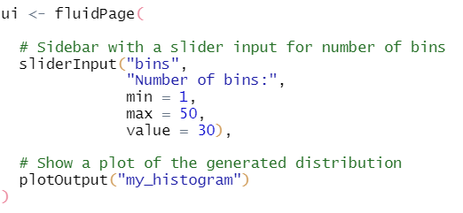
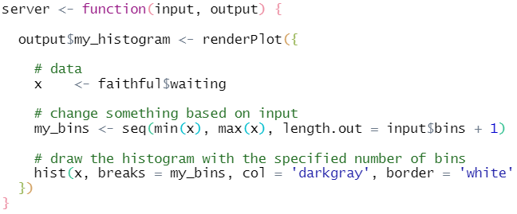
How does it work?
UI (user interface) and SERVER are chunks of code that we write, and then run.
Finally, we then run a function called “shinyApp()” which brings them to life.

Slide 6
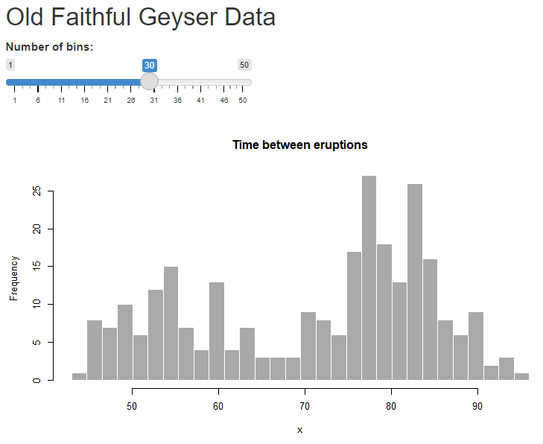

Slide 7
3.
2.
4.
6.
5.
1.

Slide 8
7.
5.
2.
1.
4.
6.
8.
3.
9.

Slide 9
2.
5.
8.
1.
6.
3.
7.
9.
4.

Slide 10
2.
9.
8.
6.
4.
1.
7.
5.
3.

Slide 11
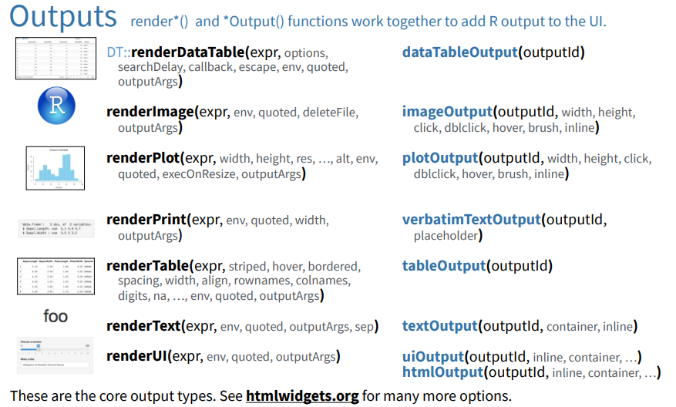





Slide 12
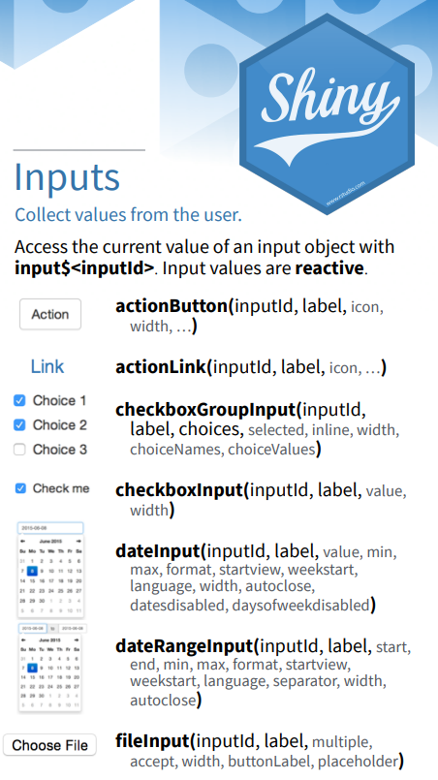
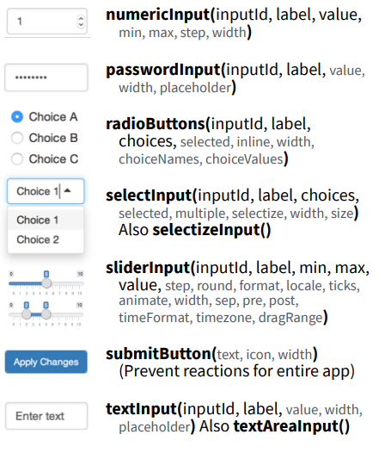

Slide 13
Useful resources
Lisa DeBruine “Building web apps with R Shiny”
https://debruine.github.io/shinyintro/index.html
Dean Atalli – Datacamp
Mastering Shiny – Hadley Wickham
Widget gallery – https://shiny.rstudio.com/gallery/widget-gallery.html

Slide 14

2. Now time to have a go for yourselves

Slide 15
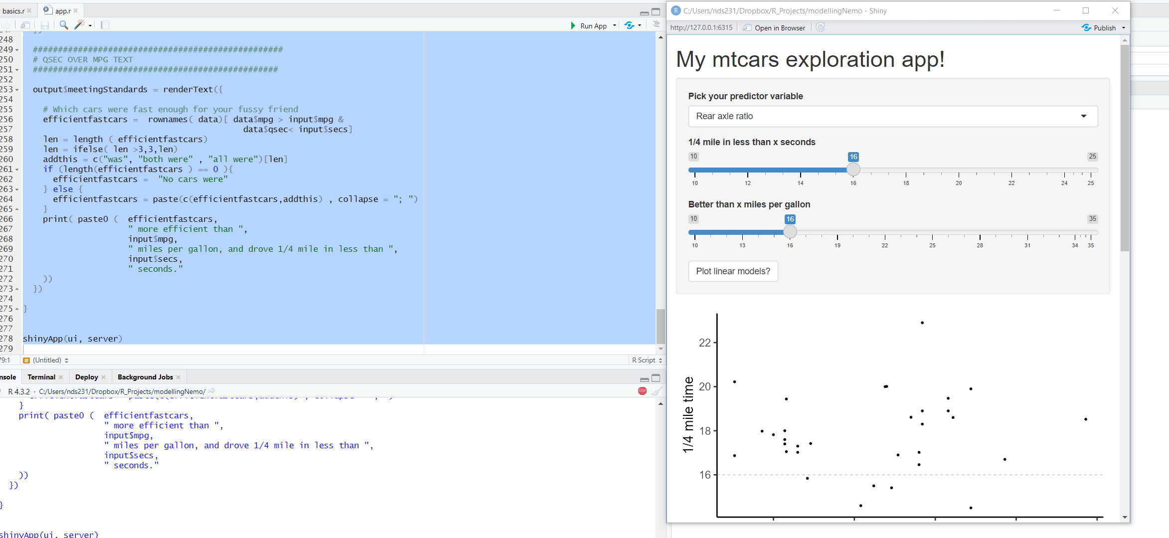



Slide 16
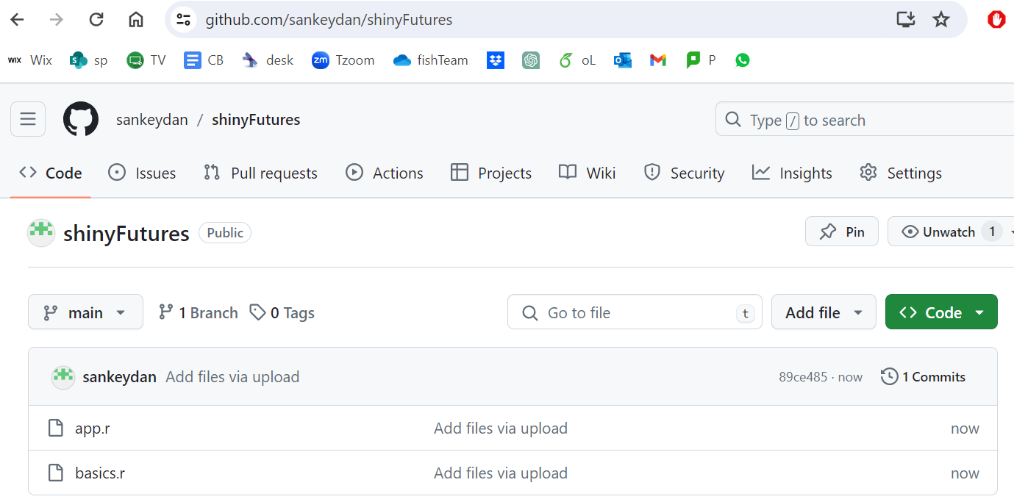

Slide 17
3. Build a shiny app - The brief
Darrel loves cars as much as he loves data. Alas, his coding skills are poor.
He wanted to know, which cars in the mtcars dataset are the fastest
But beyond that, he wants to understand the variables that predict speed, as he might be interested in cars not provided by the mtcars
Specifically he has predictions that 1. Rear axel ratio, 2. Weight, and 3. Horsepower all predict speed
He paid you for a day’s work.
Here’s what you produced

Slide 18
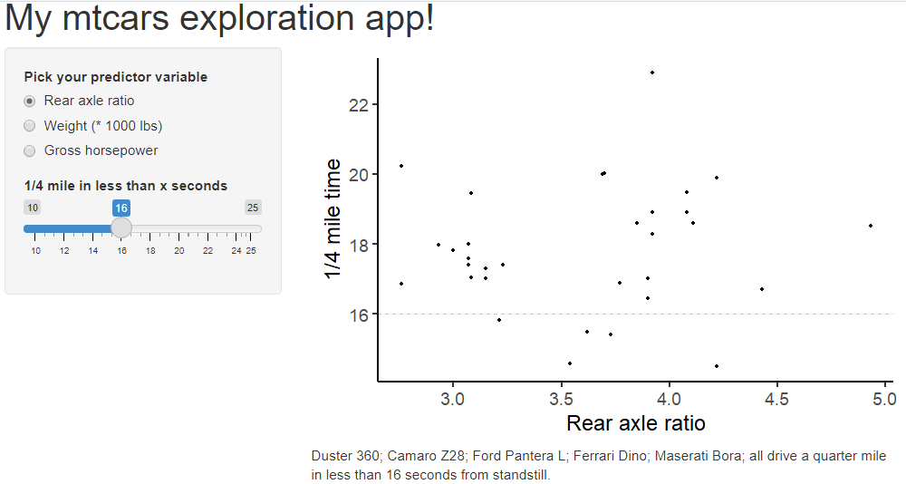

Slide 19
The brief
Just about to make a bold purchase for a Ford Pantera, Darrel suddenly got hit by the cost of living crisis.
He has now become interested in miles per gallon too. (But obviously still speed as well!)
You feel more confident on your second day as a shiny coder and he thinks you can achieve
1. Separate plots containing A) Speed, B) MPG, and C) A scatterplot of Speed vs. MPG
2. Linear model slope lines with confidence intervals and p-values
3. Here’s my app for Darrel for inspiration:
sankey-dan.shinyapps.io/ggplotMtcarsComp/

Slide 21
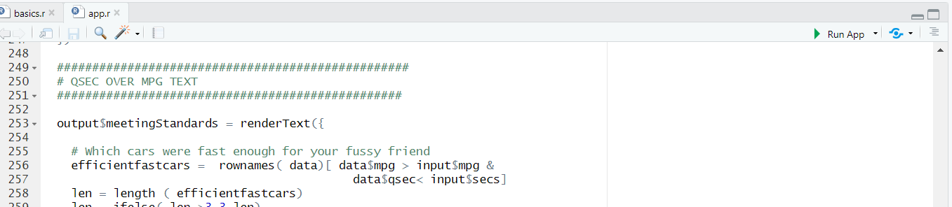



4. Deploying your Shiny App.
Easiest part of the day!
Create an account at shinyapps.io
Click “publish”
Follow a few further instructions

Slide 22
Useful resources
Lisa DeBruine “Building web apps with R Shiny”
https://debruine.github.io/shinyintro/index.html
Dean Atalli – Datacamp
Mastering Shiny – Hadley Wickham
Widget gallery – https://shiny.rstudio.com/gallery/widget-gallery.html

